Slide 1
Vue training
Andre Asselin
Principal Digital Architect
Globant

Slide 3

const instructor = 'Andre Asselin';
Worked at IBM for 20 years
Networking, storage, firmware, device drivers, tools
Have worked at Globant (previously PointSource) for 6 years

Slide 4


Some cool projects I’ve worked on

Slide 5
Topics
Unit 1: Introduction to Vue
Unit 2: Vue templates
Unit 3: Forms
Unit 4: The created() lifecycle method
Unit 5: vue-router
Unit 6: Parent-Child Communication between Components
Unit 7: Unit testing with Jest
Unit 8: Reactivity
Unit 9: VDOM
Unit 10: Lifecycle methods
Unit 11: Vuex

Slide 6
Class structure
For each topic we’ll run through the following:
Brief lecture and/or coding demo
In-class activity
Discuss solution

Slide 7
Prework verification

Slide 8
Prework items
Install Node 8.x or above
Install vue-cli 3.x
Install Vetur extension for VSCode (if you use VS Code)
Install Vue chrome extension
Register for an OMDB API key
Join the #g-s-ui-vuejs Slack channel

Slide 9
Please grab the examples and activities from github
https://github.corp.globant.com/andre-asselin/vuejs-training
Please clone into a new fresh folder:
git clone https://github.corp.globant.com/andre-asselin/vuejs-training.git

Slide 10
Unit 1: Vue intro

Slide 11
Vue 2.0 at a glance
Component based
Data down, events up
2 way data binding
Reactivity system (no dirty checking)
v-model
VDOM – extremely fast rendering
Small – 12K min+gzip
HTML or JS based templates
Server side rendering support
Support for transitions built in
Uses same classes as Angular 2 & React
Chrome debugger extension
Webpack-based build
Optional Vuex to build apps in the style of Flux/Redux
Philosophy: Start small, add required features (e.g. routing, AJAX, form validation, i18n, etc.)
Render speed | Vue | React
Fastest | 23ms | 63ms
Median | 42ms | 81ms
Average | 51ms | 94ms
95th Perc. | 73ms | 164ms
Slowest | 343ms | 453ms

Slide 12
Vue-cli demo

Slide 13
Unit 2: Templates

Slide 14
Most App UIs can be broken down into sections
Nav
Content
Sidebar
Side
Item
Item

Slide 15
Vue uses components to manage each section
Nav
Content
Sidebar
Item

Slide 16
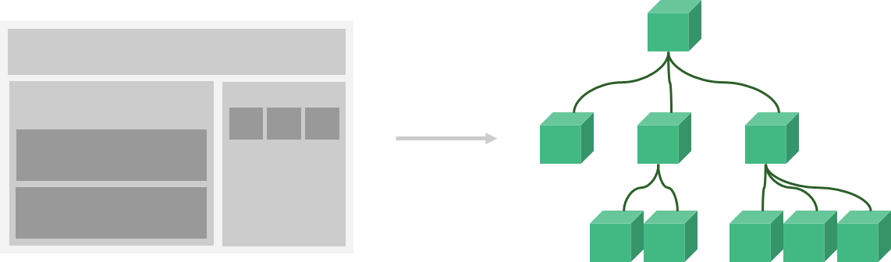
The entire UI can be abstracted into a tree of components

Slide 17
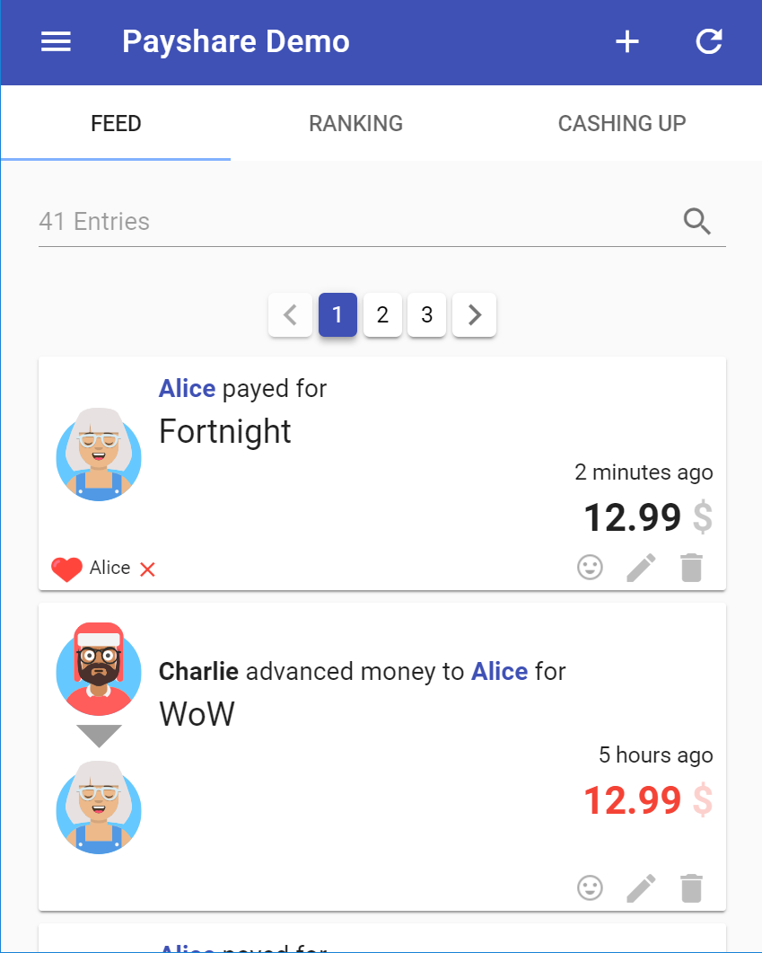
Even complex apps…
v-app
v-toolbar
v-layout
v-toolbar-side-icon
v-toolbar-title
v-btn
v-btn
v-tabs
v-tab-item
v-text-field
v-pagination
purchase
liquidation
v-tab
v-tab
v-tab

Slide 18
Why Separate UI Elements Into Components?
Allows us to logically decompose a UI into independent reusable pieces, and think about each piece in isolation
Layout and logic are bundled together in a self-contained package
Allow us to easily re-use these parts
Easier to test
We organize our components into a tree structure, just like HTML elements in the DOM

Slide 19


Each component is realized by 1 .vue file
Each .vue file represents 1 component
1-to-1 mapping
Component

Slide 20
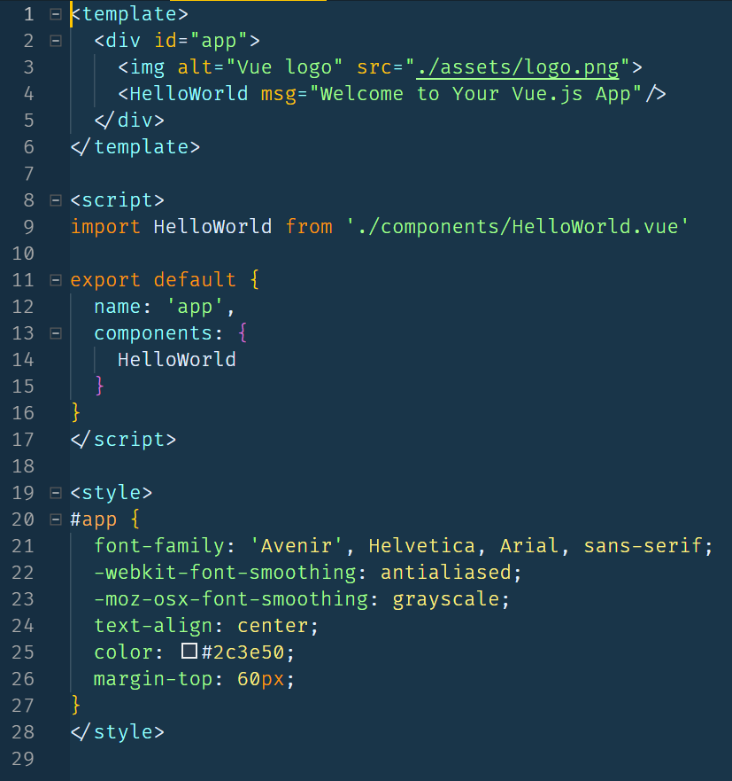
The 3 parts of a .vue file
Template – what to render on the screen
Javascript – state of the component + logic
CSS – how to style the HTML

Slide 21
Vue component’s Javascript
A Vue component is a Javascript object with certain keys (called options in the Vue doc)

Slide 22
Common Vue component options
Option (key) | Description
name | Name of the component
components | The child components that the component can use in it’s template
data | Holds the component’s state
props | A list of attributes that the component will accept from the parent component
methods | Javascript functions that may be called in the component
computed | Computed properties

Slide 23
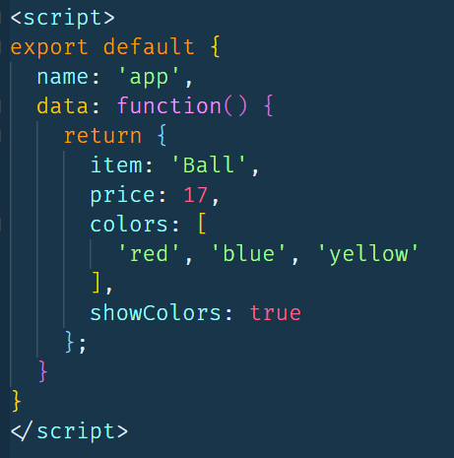
Defining state in a component
The data() key is used to store state. It is always a function that returns the initial state.

Slide 24
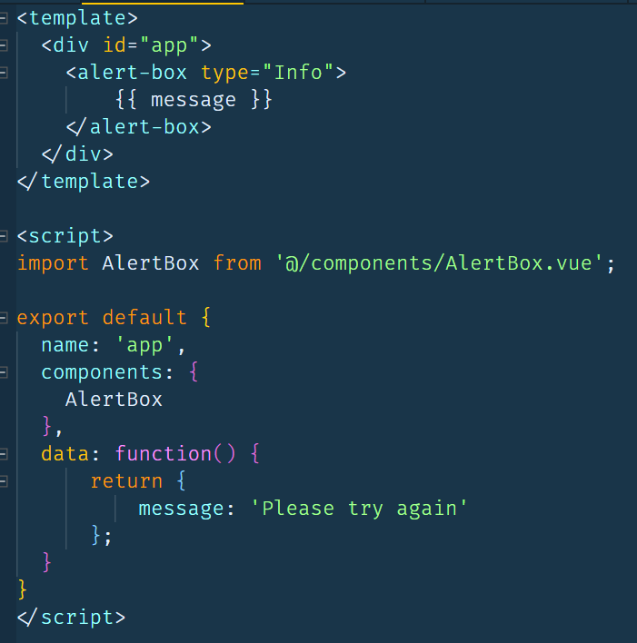
Templates have access to the component’s state

Slide 25
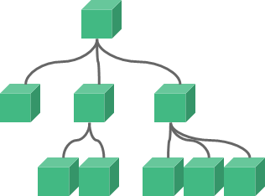
Vue combines the state with the template to create the DOM
DOM Tree
State / data()
Template
Note: This isn’t the full story (there’s VDOM involved too). More on that later

Slide 26
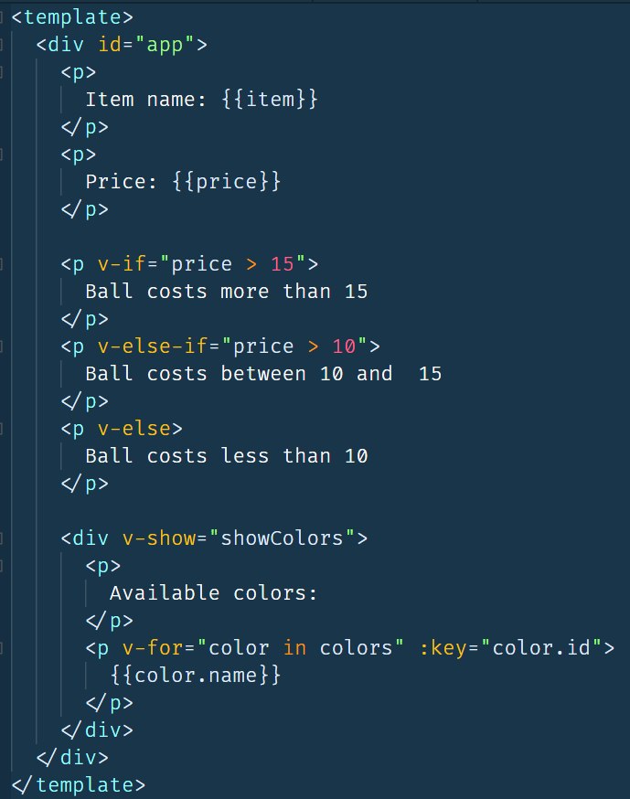
Most frequently used directives
{{ }} (Mustaches)
v-if
v-else
v-else-if
v-for
v-show
https://vuejs.org/v2/guide/#Declarative-Rendering

Slide 27
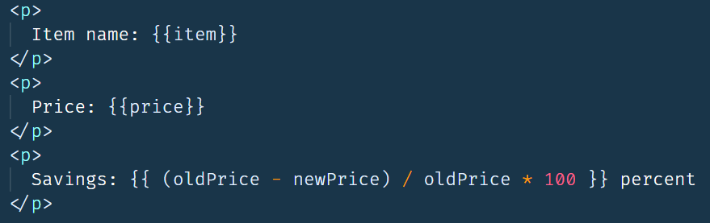
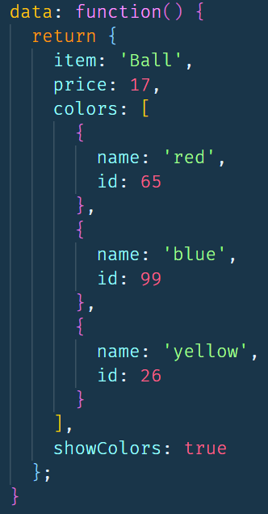

{{ }} (Mustaches)
Substitutes the current value from the state where the mustache appears
Generated HTML
Template
Script

Slide 28
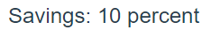
{{ }} are full Javascript expressions
In actuality, mustaches are full Javascript expressions

Slide 29

Setting the value of an attribute
You can use :attr=“value” to set the value of an HTML attribute (this can also be a full Javascript expression)

Slide 30
V-if, v-else, v-else-if
Used to conditionally include HTML
Full Javascript expression can appear in the quotes
If it evaluates to a falsy value, the HTML it appears on (and all children) will not be included in the DOM
v-else-if and v-else can be used to create complex logic

Slide 31
V-for
v-for loops over an array or object in the state
The HTML it appears on will be included in the DOM once for each entry in the array/object
:key is used to give each occurrence a unique ID
:key helps Vue efficiently re-render the template if it should ever need to change
Often a database ID
But it can be anything we can guarantee to be unique

Slide 32
V-show
v-show is like v-if in that it’s used to conditionally display HTML
Unlike v-if, the HTML is always generated and included in the DOM
If it evaluates to a falsy value, the DOM will have a “display: hidden;” style included on it
Note: v-else-if and v-else can’t be used with v-show

Slide 33
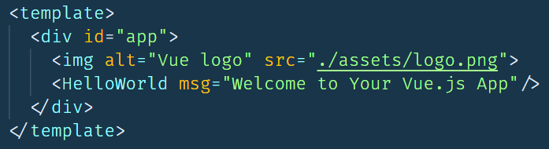
NOTE: A Template must have a single parent element
In a template, you can create as much HTML as you’d like as long as it’s wrapped in a single parent element

Slide 34
Demo: examples/02-templates

Slide 35
Unit 3: Components & Forms

Slide 36
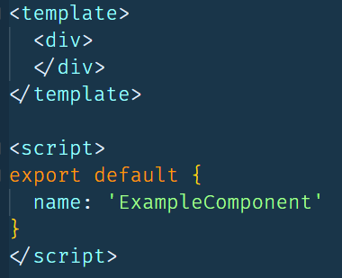
How to Create a component
(Optionally) Create a folder
Create <ComponentName>.vue file
Note: Best practice says to use at least 2 words for the component name
Start with a minimal file

Slide 37
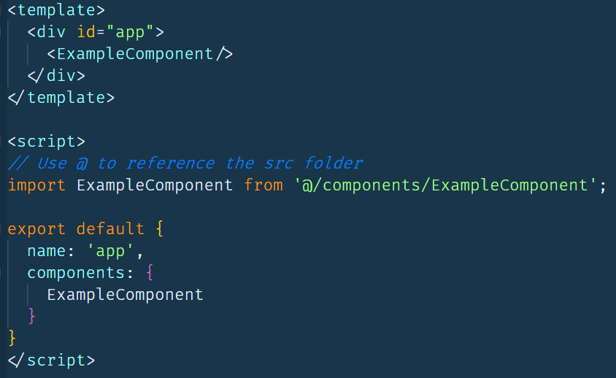
How to use a component from another component
Import the desired component into the file you want to use it from
Add it to the components option
Reference it in the template

Slide 38
ES6 import / export
import and export are new keywords added to ES6
Similar to node’s require() and module.exports
2 common patterns with import/export
Default export
Named exports

Slide 39
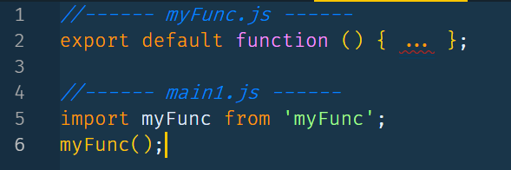
ES6 default import / export
Used to export 1 thing from a file

Slide 40
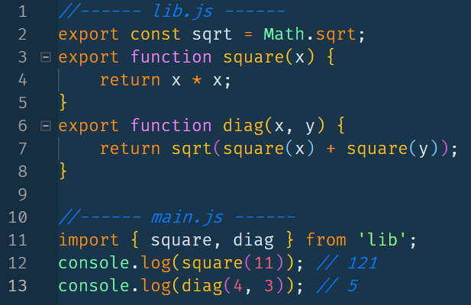
ES6 named import / export
Used to export multiple things from a file

Slide 41
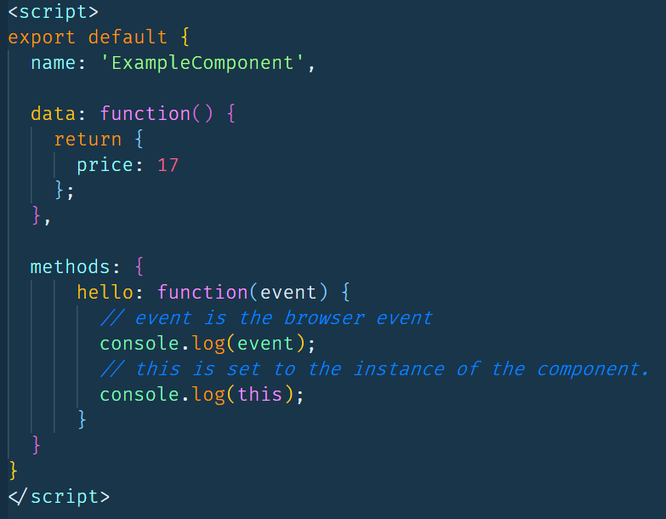
Responding to browser events
You can use the methods key to define Javascript functions that can be bound to browser events

Slide 42

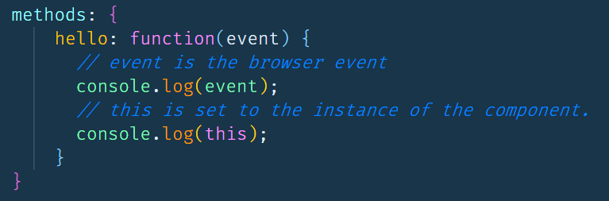
Responding to browser events
Use @<eventname> to specify the browser event (e.g. click, changed, mouseover, etc.)
The value of the attribute is the name of the function to run

Slide 43
How can we keep the DOM and state in sync?
DOM
State
???

Slide 44

Example: Update the state when the user changes an input field

Slide 45
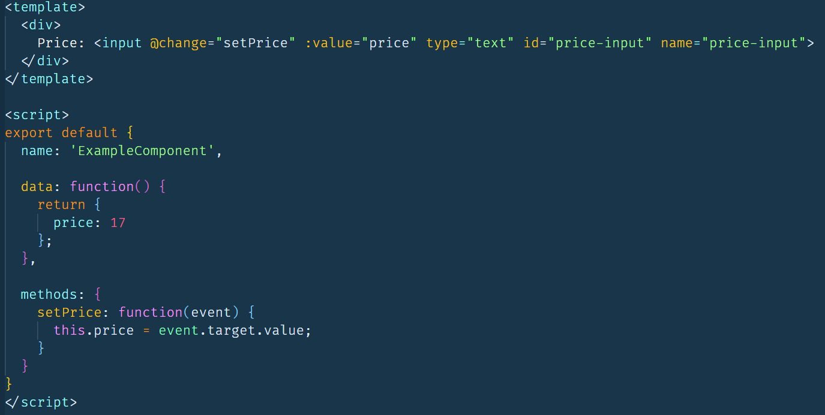
Updating state using methods
One way is to update the state on a change event, and set the value of the input field using the :value attribute
Con: This can result in a lot of boilerplate code if there are a lot of input fields

Slide 46
V-model sets up 2-way binding between an input field and the state
The value of v-model is the name of the state variable to keep in sync with the input field
v-model is actually shorthand for the @change / :value pattern on the previous slide

Slide 47
Demo: examples/03-forms

Slide 48
V-model sets up 2-way binding between the DOM and the state
DOM Tree
State / data()
Template

Slide 49
Note on v-on and v-bind
We’ve been using @click = “eventHandler” and :attr=“prop” to bind events and state
@click and :attr are shorthand ways to do that
The full way is
@click=“eventHandler” → v-on:click=“eventHandler”
:attr=“prop” → v-bind:attr=“prop”
They are the same– no difference between them other than the number of characters you need to type ☺

Slide 50
Homework activities
Homework activities are in the “activities” folder
The README.md file has directions
Solutions are in the “Solved” folder (no peeking!)

Slide 51
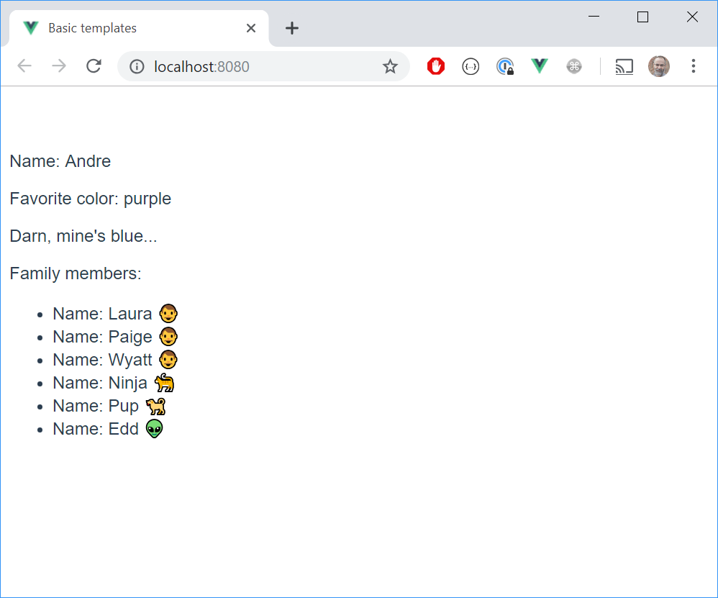
Activity 02-templates
Practice using Vue’s template language and data() option for state

Slide 52
Activity 03a-Components
Create your first Vue component!

Slide 53
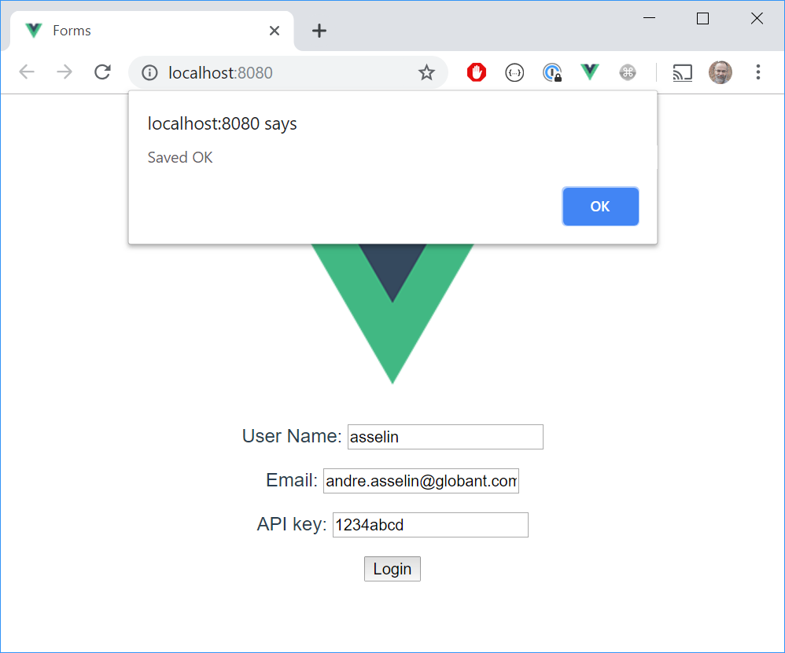

Activity 03B-Forms
Create a basic login page that saves information to localStorage

Slide 54
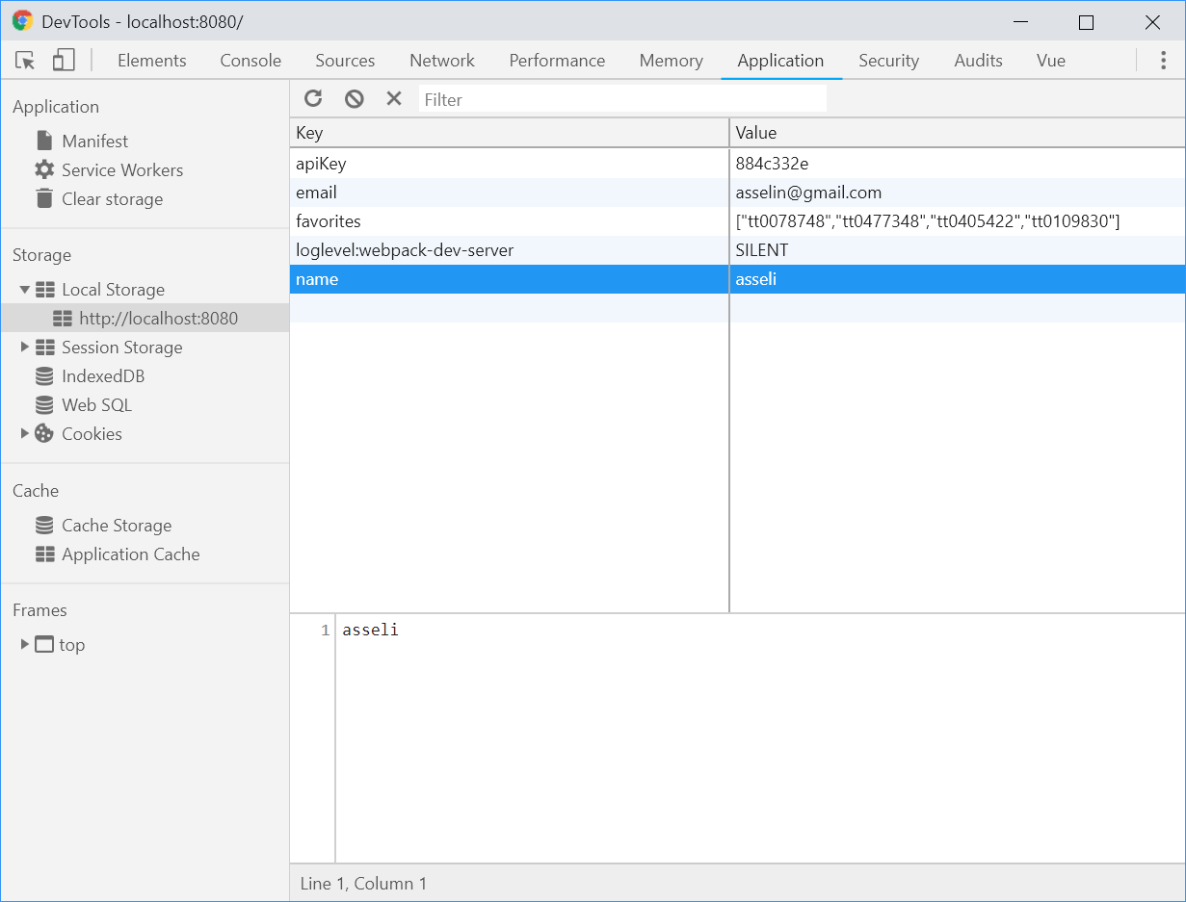
localstorage
Data that is stored locally in the browser
API
localStorage.setItem(key, value)
localStorage.getItem(key)

